Slide 1
WELC ME to the PRESENTATION
Of Learning Psychology

Slide 2
TODAY’S AGENDA
What will we learn in this presentation?
Who is Thorndike?
What is Thorndike's theory of connectionism?
What are the educational implication of Thorndike learning theory?

Slide 3
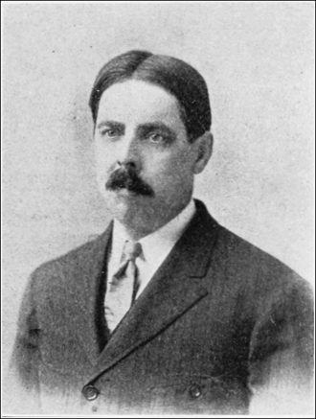
WHO IS THORNDIKE?
Edward Lee Thorndike (August 31, 1874 – August 9, 1949) was an American psychologist who spent nearly his entire career at Teachers College, Columbia University. His work on comparative psychology and the learning process led to the theory of connectionism and helped lay the scientific foundation for educational psychology.

Slide 4
Continue…
WHO IS THORNDIKE?
Edward Thorndike had a powerful impact on reinforcement theory and behavior analysis, providing the basic framework for empirical laws in behavior psychology with his law of effect. Through his contributions to the behavioral psychology field came his major impacts on education, where the law of effect has great influence in the classroom.

